Slide 1

ROCKBUSTER STEALTH FILM SALES STRATEGY 2020
Rachel Perry

Slide 2
AGENDA
INTRODUCTION
ROCKBUSTER DATA OVERVIEW
KEY QUESTIONS
ANALYSIS
KEY FINDINGS
RECOMMENDATIONS
CLOSING

Slide 3
INTRODUCTION
Rockbuster Stealth LLC is a movie rental company that used to have stores around the world. Facing stiff competition from streaming services such as Netflix and Amazon Prime, the Rockbuster Stealth Management team is planning to use its existing movie licenses to launch an online video rental service in order to stay competitive.
It is our objective to help Rockbuster Stealth's business intelligence (BI) department with the launch strategy for the new online video service.

Slide 4
DATA OVERVIEW
COUNTRIES REPRESENTED
REVENUE
CUSTOMERS
TOTAL FILMS
GENRES
$61,312
599
108
1000
20
AVG REPLACEMENT COST
AVG RENTAL COST
AVG RENTAL DURATION
ALL FILMS RELEASE YEAR
MOST POPULAR GENRE
$2.98
4.99 days
$19.99
2006
PG

Slide 5

KEY QUESTIONS
Which movies contributed the most & least to revenue gain?
What was the average rental duration for all videos?
Which countries and cities are Rockbuster customers based in?
Where are customers with a high lifetime value based?
Do sales figures vary between geographic regions?

Slide 6
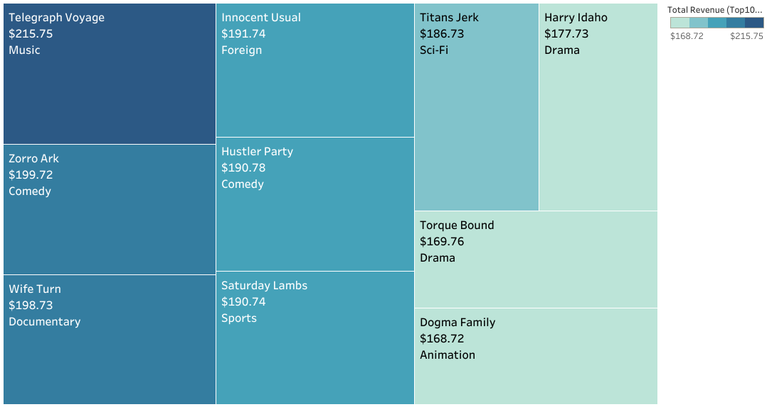
REVENUE by film
Two of the top 5 movies are in the Comedy Genre
173 movies out of 1000 generate revenue over $100
The bottom 10 movies generate revenue under $8.00

Slide 7
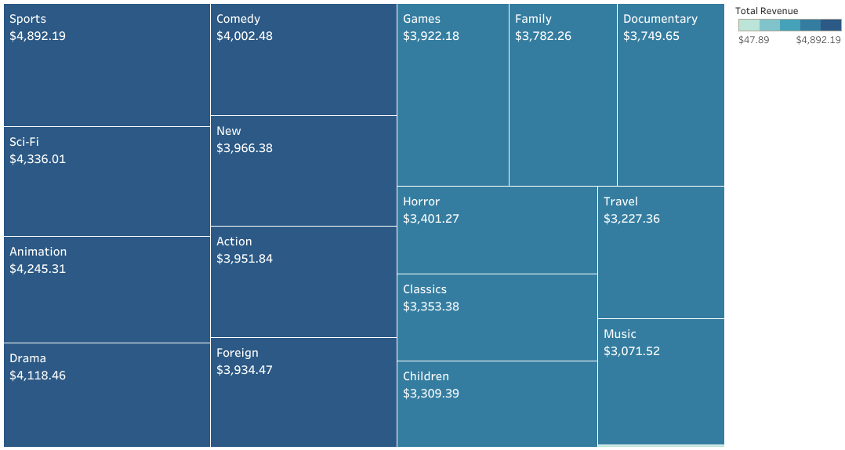
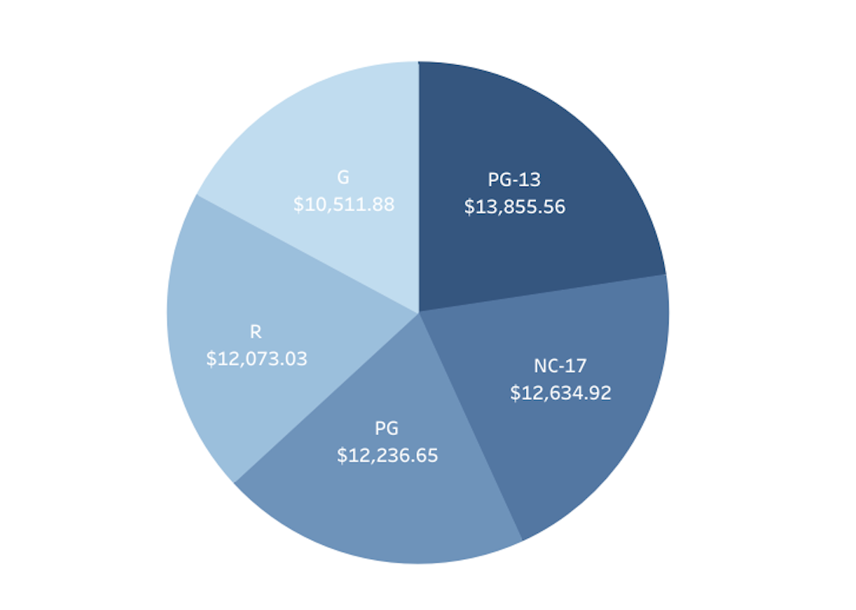
REVENUE by Genre & RATING
Top 5 Genres - Sports, Sci-Fi, Animation, Drama & Comedy
Thriller (not listed) the is the weakest genre – generating $47.89
PG-13 followed by NC-17 generate the most revenue

Slide 8
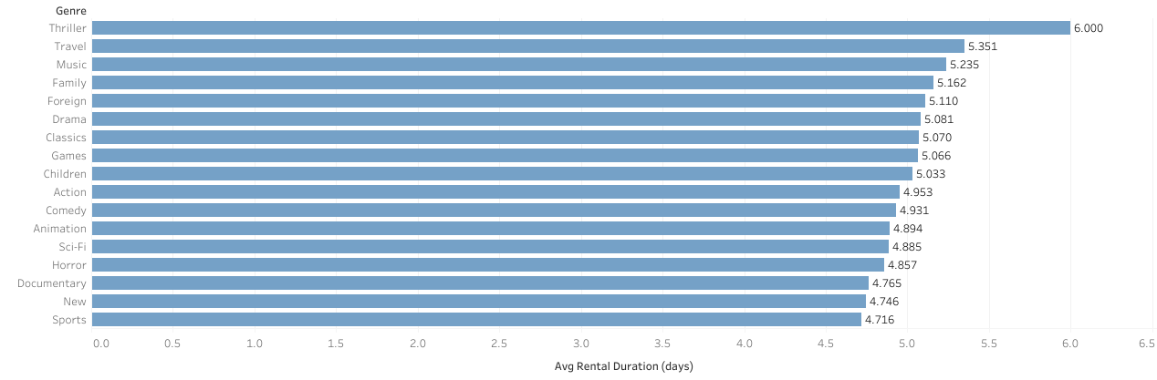
AVERAGE RENTAL DURATION
Thriller has the highest average rental duration of 6 days
Sports has the lowest rental duration of 4.7 days
The average rental duration overall is 4.99 days

Slide 9
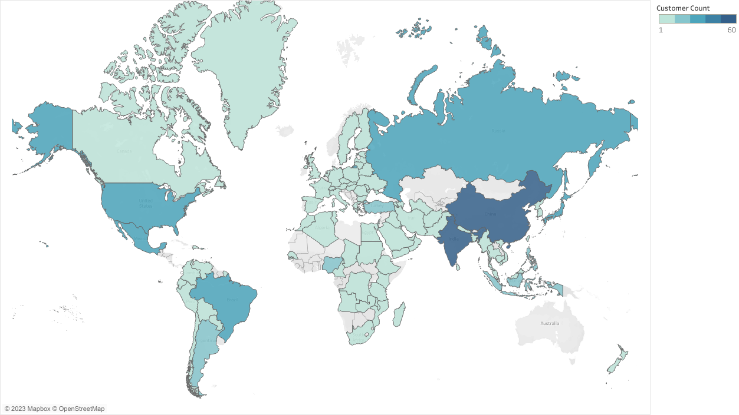
Customers by country
TOP 5
India (60)
China (53)
United States (36)
Japan (31)
Mexico (30)
41 Countries have just 1 customer
14 Countries generate revenue of over $1000

Slide 10
CUSTOMER LOCATIONS AND REVENUE
There is a correlation between customers and revenue within each country
Of the top cities in the top countries only 1 city had multiple customers – Aurora, United States
3 of the top 10 cities are in China – Shanwei, Tianjin & Hami

Slide 11
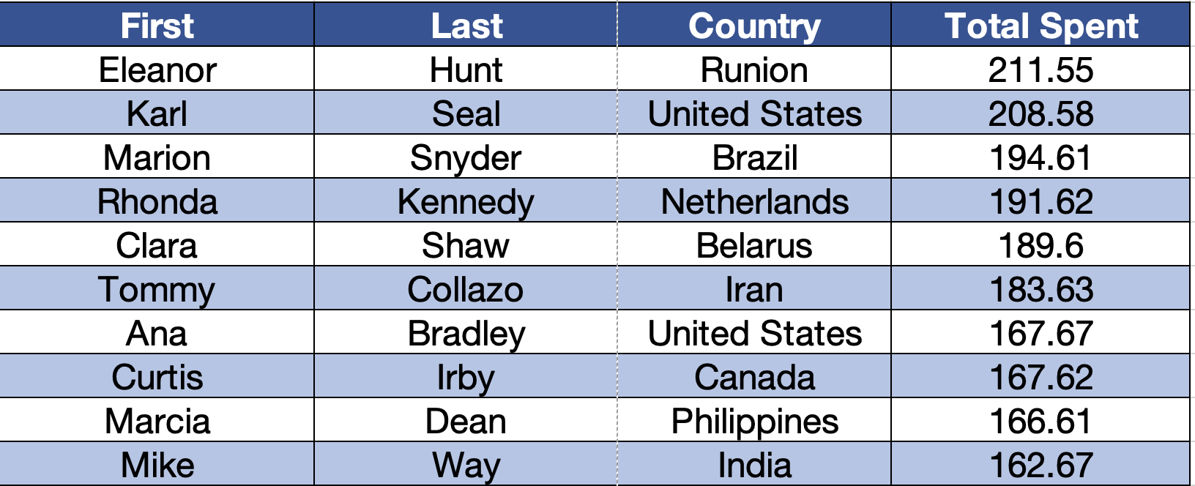
Highest Lifetime Customers

Slide 12

Key Findings
The top genres are Sports, Sci-Fi, Animation, Drama & Comedy
India, China and the United States have the most Rockbuster customers and generate the most revenue
There are 108 Countries reached by Rockbuster and 599 customers
The top 10 revenue generating countries are responsible for over half of the total revenue

Slide 13

RECOMMENDATIONS
Focus on expanding the film library to movies beyond just in 2006
Focus on the Sports, Sci-Fi, Animation, Drama & Comedy genres as they generated the most revenue
Add TV Shows to the streaming as this will help Rockbuster up to speed with competitors
Incorporate a reasonable monthly subscription fee to attract customers along with a discounted yearly fee in hopes to get long term customers
Marketing focus in India, China & United States

Slide 14
Thank you
Rachel Perry – RachelMoreland6@gmail.com
Tableau Storyboard: Rockbuster Visuals
Data Outputs: SQL Summary

